Slide 1


HOTEL REVENUE ANALYSIS

Slide 2



TEAM MEMBERS
Mayuri Gaikwad ​
Madhukar Eethakota
Mohini Wagh​​
Sai Krishna​
Archana Ganesh​
Harshvir Singh
Under Guidance of :​
Mentor Mukilan Selvaraj

Slide 3

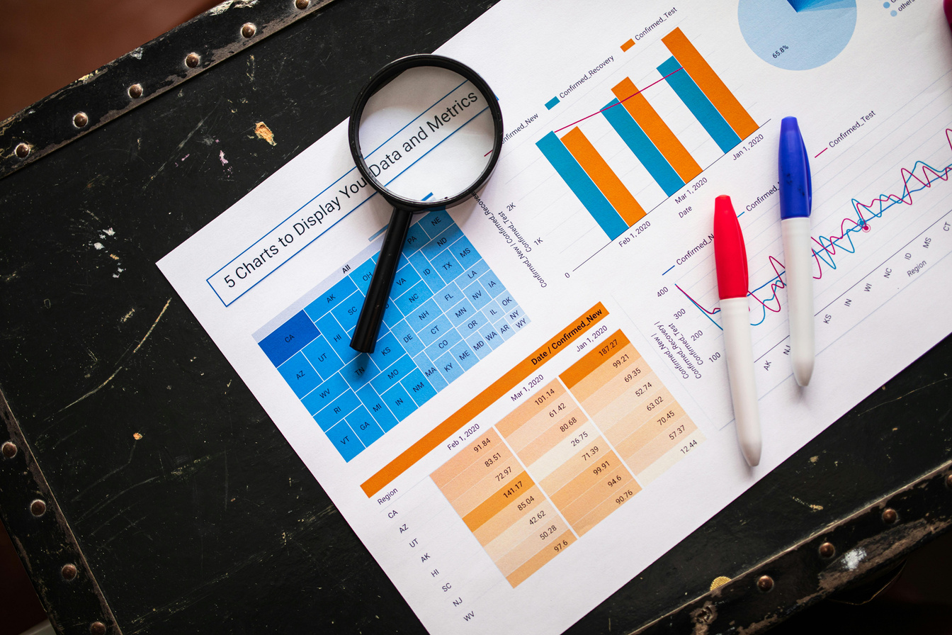
OVERVIEW
Introduction
Project Overview
Tech stack
Milestones
Star Schema
Dashboards
Conclusion

Slide 4
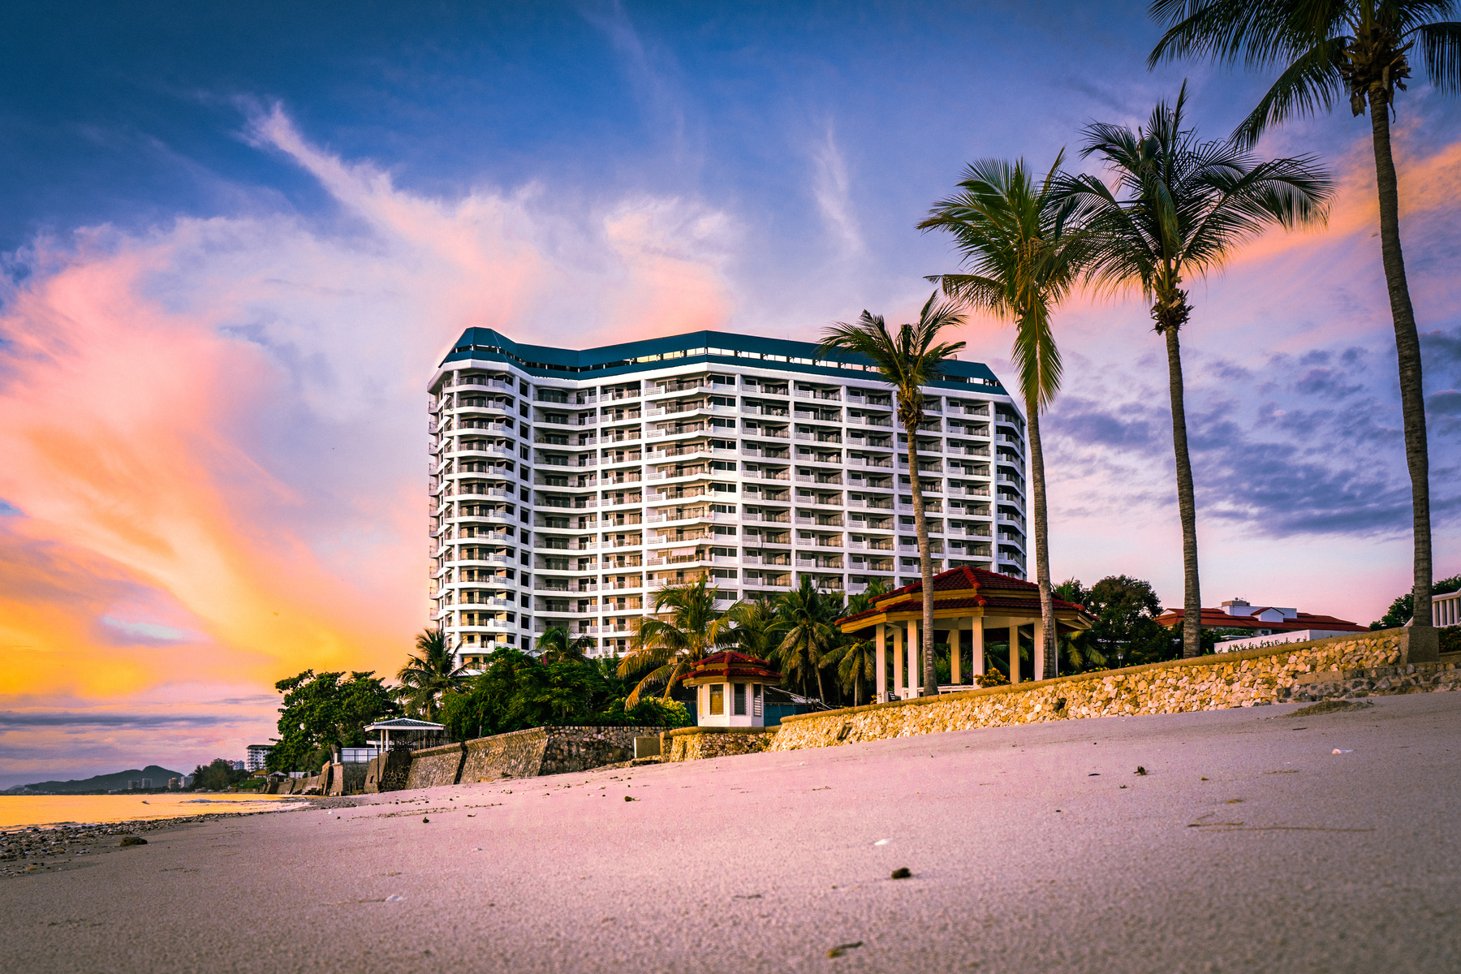

INTRODUCTION
Project Statement
Hotels must understand their occupancy patterns, guest demographics, and pricing effectiveness to improve revenue. This project builds an analytical solution in Power BI to track room bookings, average daily rates, guest profiles, and seasonal trends. It helps hotel management make informed decisions around promotions, upselling, pricing strategies, and room optimization.
Project Overview
Collecting and cleanining customer related data.
Building a structured data model for analysis.
Creating dashboards showing key metrics: occupancy, revenue, and customer behavior.
Analyzing booking patterns and trends.
Helps hotel management optimize resources and make data-driven decisions.

Slide 5
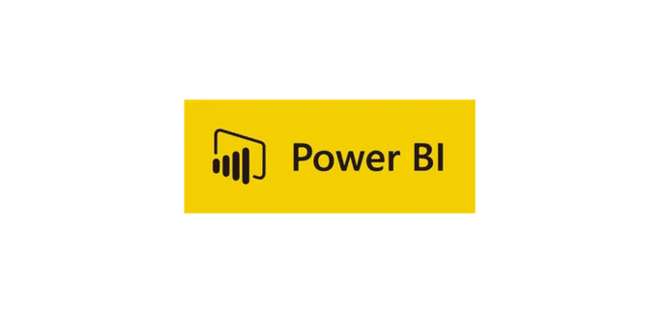





TECH STACK
Business Intelligence Tool : Power BI
Data Transformation : Power Query
Python-based Data App : Streamlit , NumPy , Pandas

Slide 6






MILESTONE
1
2
3
4
5
Completed ingestion of booking, customer, and room data, performed cleaning and transformation, and designed a validated star schema with relationships.
Developed KPI measures (Occupancy %, ADR, RevPAR), created interactive dashboards, and visualized performance trends across time, location, and booking sources.
Analyzed guest profiles by nationality, booking channels, and stay duration, and segmented customers into first-timers, loyal guests, and high spenders.
Built forecasting visuals to predict occupancy and revenue, and analyzed cancellation rates, no-shows, and lead-time patterns affecting hotel performance.
Designed a strategic dashboard highlighting pricing tiers, seasonal demand, and upsell opportunities, delivering actionable insights for data-driven decisions.

Slide 7


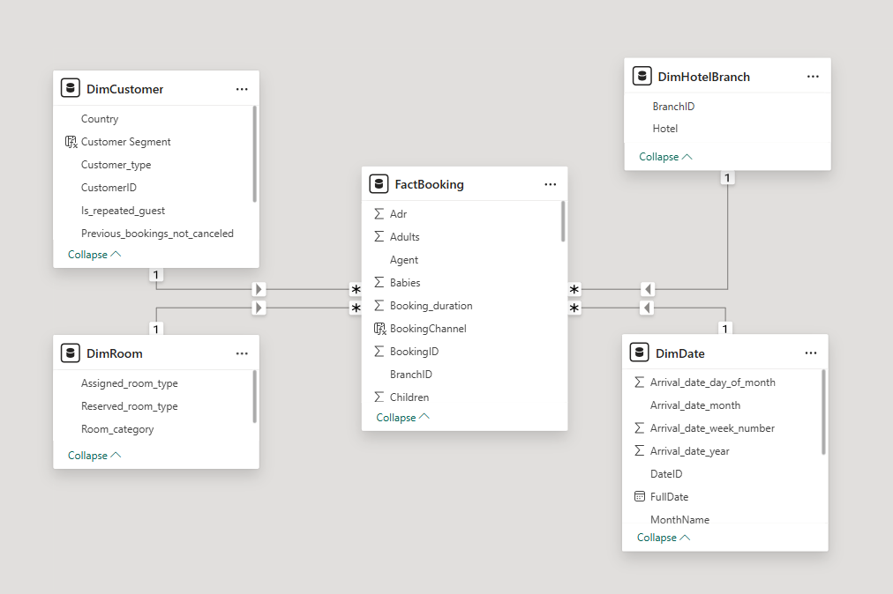
STAR SCHEMA

Slide 8
DATA INGESTION & MODELING
Collected and integrated raw hotel booking data from multiple sources, including customer info, room categories, and reservation records.
Performed data quality checks to identify and resolve missing values, duplicates, and inconsistencies in dates and room types.
Cleaned and transformed the data using Power Query by formatting dates, renaming columns, and standardizing customer and room details.
Created dimension tables (Customer, Room, Date) and a central FactBooking table to store booking IDs, room info, customer IDs, and status.
Designed and validated a Star Schema model with proper relationships and tested it using aggregations like total bookings per room category.

Slide 9
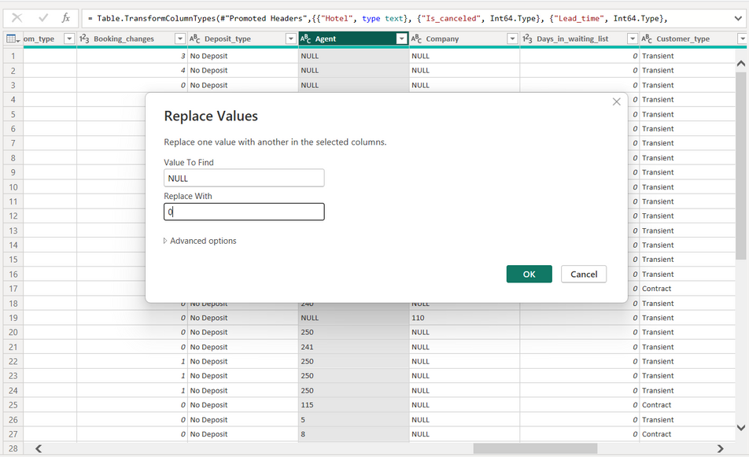
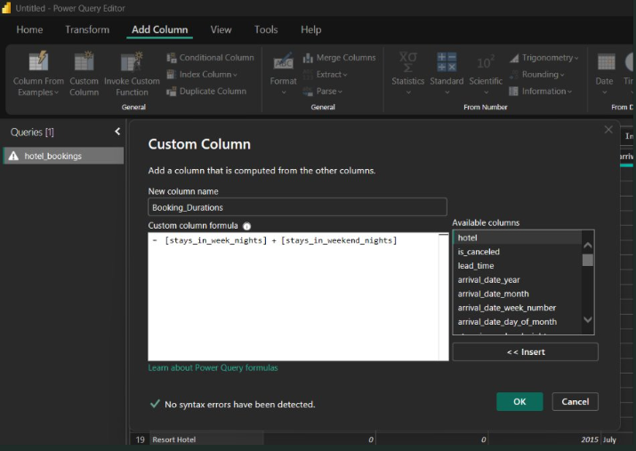
DATA TRANSFORMATION
Data cleaning ways:- ​
Missing values​
Duplicate entries​
Wrong or inconsistent formats​
Extra spaces or symbols​
Invalid records​
​
Derived Columns
BookingDuration =​stays_in_weekend_nights + stays_in_week_nights​
​
Total Guests = adults + children + babies​
​
Revenue = adr × (stays_in_weekend_nights + stays_in_week_nights)​

Slide 10
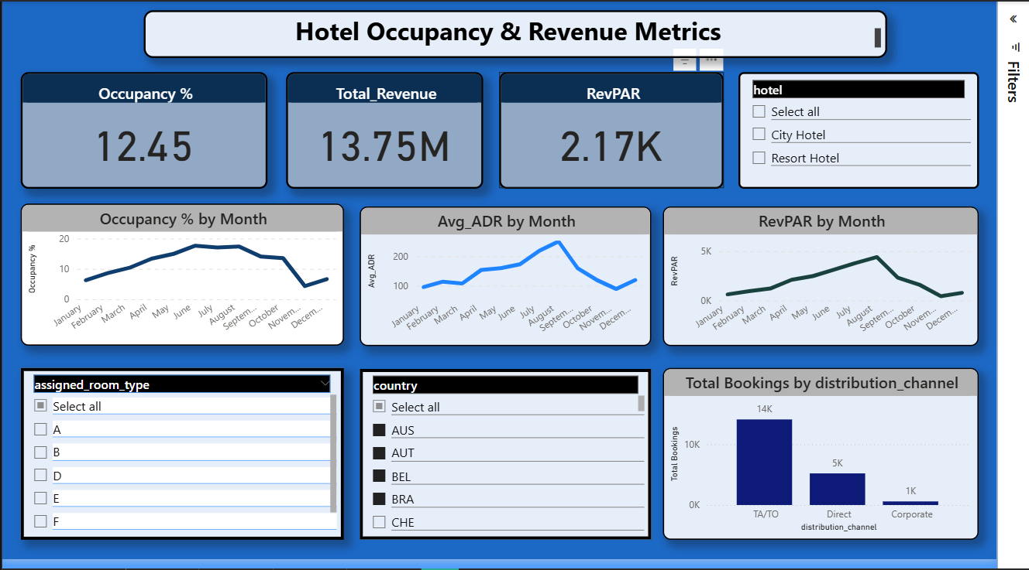
OCCUPANCY & REVENUE METRICS

Slide 11
OCCUPANCY & REVENUE METRICS
Imported and modeled data using a Star Schema to ensure efficient performance tracking across key hospitality metrics.
Visualized occupancy trends, ADR, and RevPAR using interactive line charts, bar graphs, and KPI cards for quick insights.
Enabled dynamic time-based analysis through slicers for year, month, and season to monitor trends over custom periods.
Compared booking performance across channels (Direct vs. OTA) and tracked customer segments (first-time, repeat, loyal).
Designed clear, user-friendly dashboards with labeled visuals, intuitive navigation, and impactful insights for decision-makers.

Slide 12
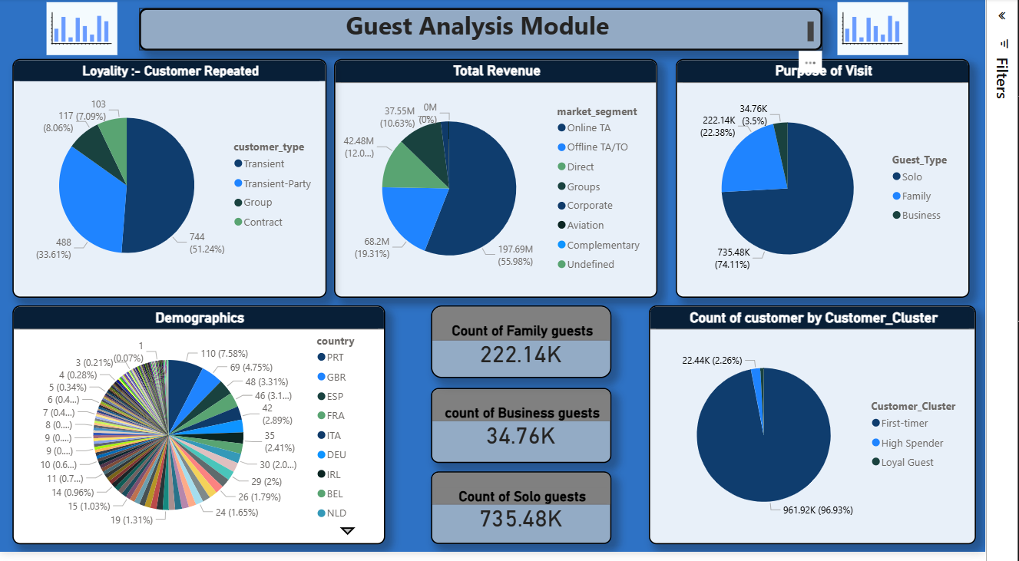
GUEST ANALYSIS MODULE

Slide 13
GUEST ANALYSIS MODULE
Segmented guests into categories like first-time, repeat, loyal, and high-spending customers to understand behavior patterns.
Analyzed demographics and booking behavior including nationality, age group, stay duration, and booking source.
Developed DAX measures to track key metrics like total bookings, repeat rate, and segment contribution over time.
Built visuals such as pie charts for guest types, maps for nationality, and bar charts for demographic distribution.
Delivered insights for targeted strategies like personalized promotions, loyalty programs, and improved guest experiences based on data-driven profiles.

Slide 14
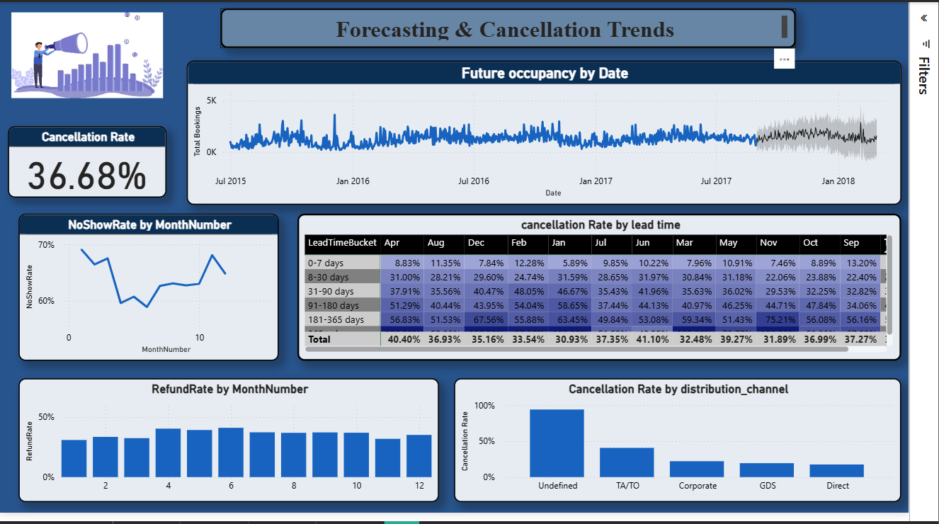
FORECASTING AND CANCELLATION TRENDS

Slide 15
FORECASTING AND CANCELLATION TRENDS
Developed occupancy forecasts using historical booking data, revealing seasonal patterns and long-term demand trends with interactive line charts.
Analyzed cancellation rates across room types, booking channels, and customer segments to identify high-risk areas.
Studied lead time, no-show, and refund trends to understand guest behavior and timing of cancellations.
Linked cancellation impact to key metrics like ADR and RevPAR to measure revenue loss and optimize pricing strategies.
Provided actionable insights for demand planning through combined forecasting and cancellation analysis, enabling better room allocation and revenue optimization.

Slide 16
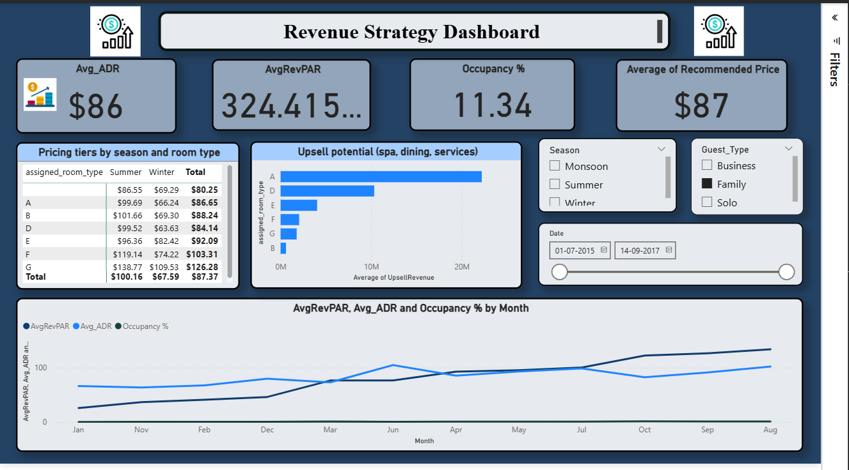
REVENUE STRATEGY DASHBOARD

Slide 17

REVENUE STRATEGY DASHBOARD
Integrated pricing tiers and seasonal analysis by room type to support strategic decisions on rate adjustments and promotions.
Analyzed upsell potential across spa, dining, and other services to uncover new revenue streams and customer preferences.
Enabled interactive filtering by season, booking channel, room category, and customer segment for tailored analysis by revenue managers and GMs.
Delivered actionable insights through visual tools like recommendation cards, seasonal pricing matrices, and upsell opportunity charts to drive revenue growth and optimization.

Slide 18
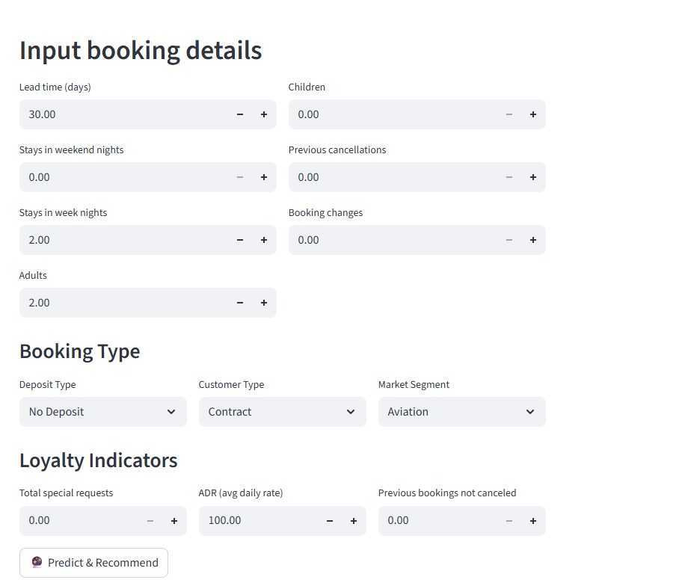
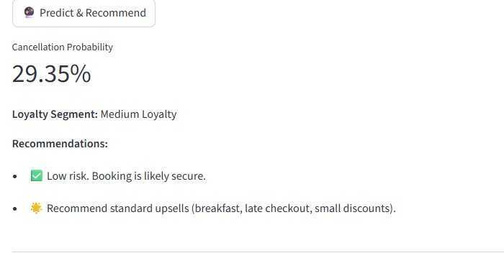
AI MODULE (STREAMLIT APPLICATION)

Slide 19
AI MODULE (STREAMLIT APPLICATION)
Developed an AI-powered interface in Streamlit to make hotel analytics more interactive and user-friendly.
Integrated machine learning models to provide demand forecasting and identify potential upselling opportunities.
Implemented cancellation prediction to estimate the likelihood of booking cancellations using historical data patterns.
Enabled dynamic recommendations for pricing strategies, seasonal promotions, and service optimization (e.g., spa or late checkout offers).
Provided real-time insights through a web-based app, allowing management to simulate scenarios and make faster decisions.

Slide 20
CONCLUSION
Built a structured Star Schema data model integrating bookings, customers, rooms, and time data for efficient analysis in Power BI.
Cleaned, transformed, and standardized raw datasets, creating a reliable foundation for accurate business reporting.
Developed interactive dashboards to visualize hotel performance, including KPIs like ADR, RevPAR, Occupancy Rate, and Cancellation %.
Designed analytical modules, including Guest Analysis (demographics, loyalty, behavior) and Forecasting/Cancellation Trends to support strategic planning.
Created a Revenue Strategy Dashboard to monitor financial performance and support pricing, promotions, and upselling decisions.
Enabled time-based insights (year/month/season) and delivered actionable intelligence to improve room allocation, customer satisfaction, and revenue growth.

Slide 21

Thank You

